Slide 1
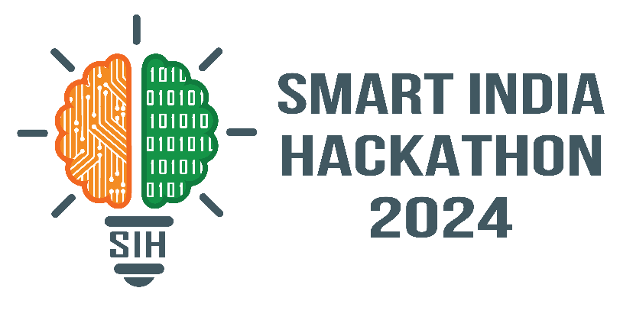
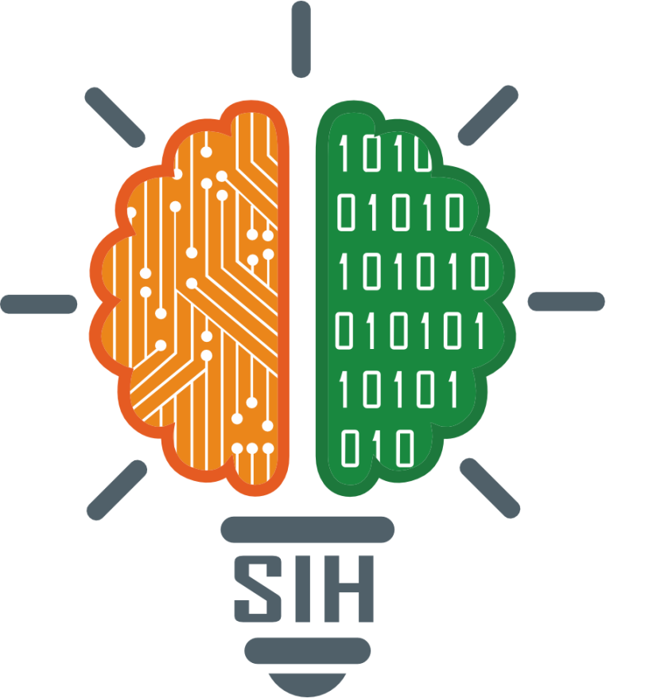
SMART INDIA HACKATHON 2024
Problem Statement ID – 1570
Problem Statement Title - Designing and development of a pressure transducer-based equipment with a well cap for measurement of heads in autoflow wells
Theme - Miscellaneous
PS Category - Hardware
Team ID - 49818
Team Name (Registered on portal) – AZTECS ECE

Slide 2
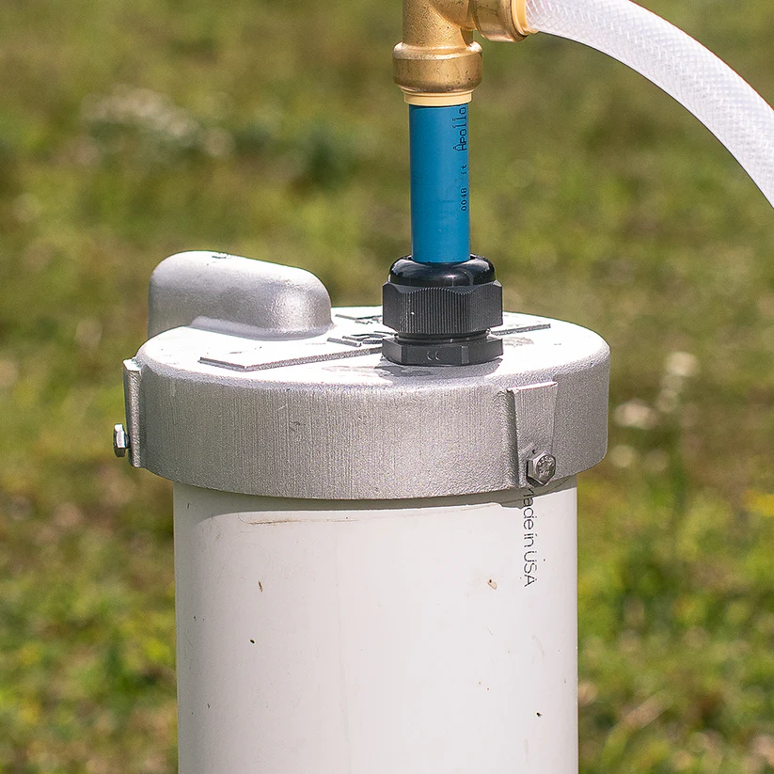
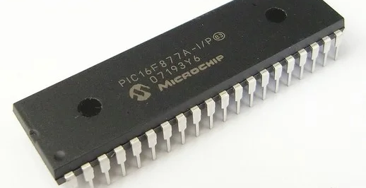
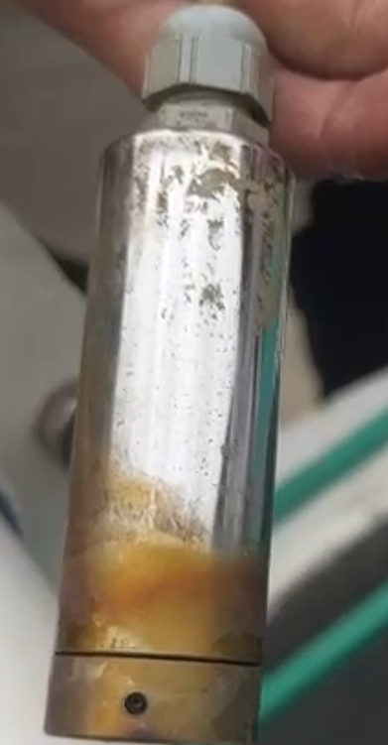
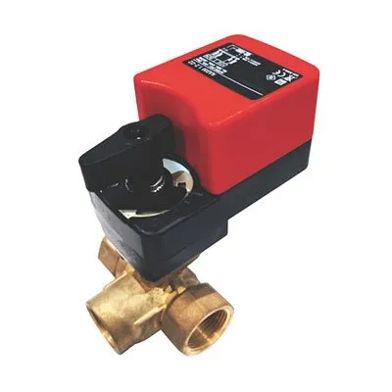
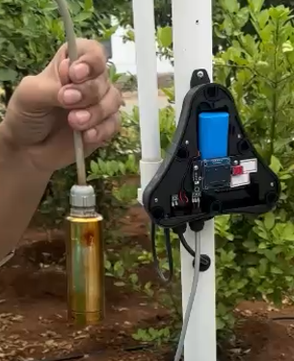
Proposed Solution
Block Diagram
Methodology
Pressure Transducer: Submerged in the well at a specific depth, to measure the water level.
PIC Microcontroller: Used to convert the pressure readings into the water height above ground level using the formula: h = P / ρ*g Where h = water height, P = pressure, ρ = water density, and g = gravitational constant.
Electronic Valve: Automatically controls the flow of water by opening the valve when a threshold water level is reached.
External Storage Tank: Collects excess water when the solenoid valve opens, preventing water wastage.
Well Cap: To control overflow and to depressurize the well water
Main Controlling Unit
Well cap
[To stop overflow of water]
Innovation and uniqueness of the solution
Water level is measured using pressure for accurate & constant analysis.
The overall system operation is powered using Solar power in the same field.
Waterflow is controlled automatically with respect to the water level
Electronically controlled Valve
[To control water flow]
Field data can be monitored in the OLED screen
Proposed pressure transducer – For water level measurement
(Internal structure)

Slide 3
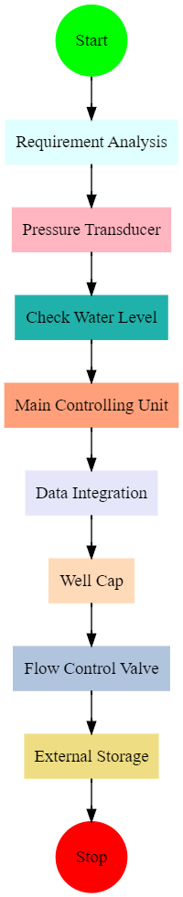
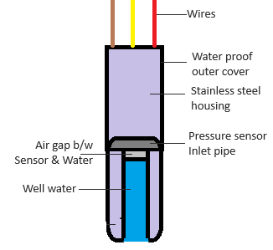
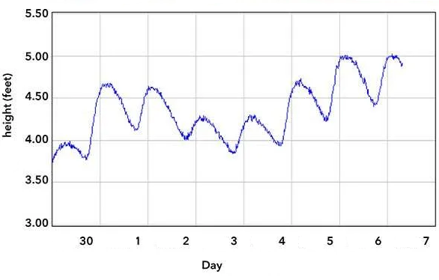
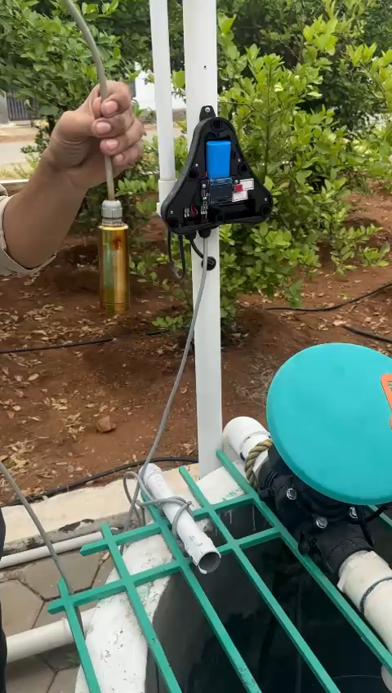
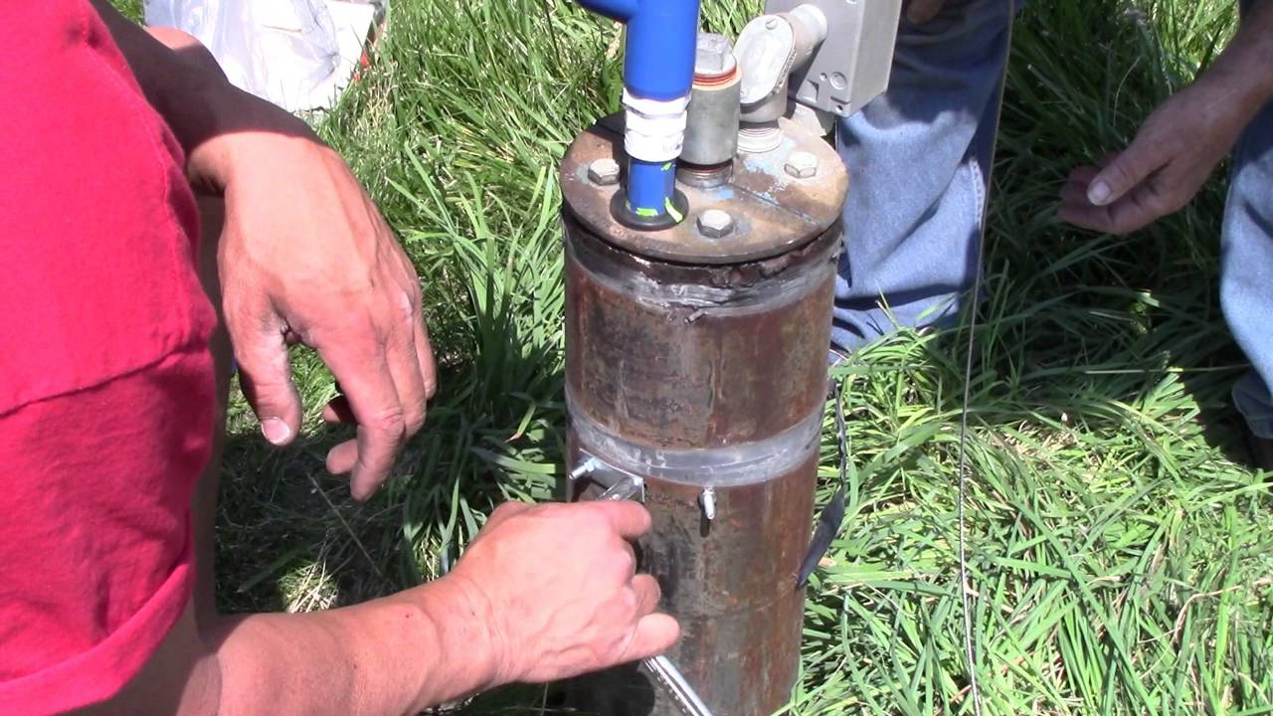
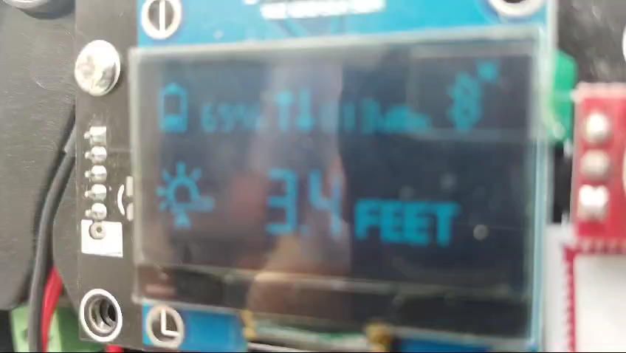


TECHNICAL APPROACH
AZTECS
FLOWCHART
TECHNOLOGIES USED:
C/C++ : to code microcontroller | Microcontroller : PIC16877A |
Sensor : pressure Transducer | Valve : Actuator valve , zero pressure valve | Solar | OLED | Touch control |
Working prototype
Proposed pressure transducer (Internal structure)
Measurement of ground water level
Well cap
Submerging proposed pressure transducer
Demo video & Resources
Display of Height difference between
sensor and water level

Slide 4
IMPACT AND BENEFITS
AZTECS
Slogan: Empowering communities
Potential impact on the target audience
Benefits of the solution
Target audience : Farmers, Private well owners & Environmentalists
Social Benefits:
Promotes responsible water usage and conservation within local communities
Ensures reliable, controlled water flow for communities in rural areas
Economic Benefits:
Minimal upkeep required, offering long-term economic relief
Efficiently utilizes groundwater for agriculture and domestic needs
Environmental Benefits:
Protects groundwater resources and mitigates the risk of depletion
Preserves local ecosystems by minimizing water depletion
Farmers | Private well owners | Environmentalists
Improved irrigation control | Efficient water management | Helps conserve groundwater and prevent depletion
Reduces the need for alternative water sources and pumping costs | Lower maintenance efforts | Promotes sustainable water usage
Sustained groundwater access | Prevents water loss, lowering operational and maintenance costs. | Control desertification
The system helps prevent groundwater depletion, ensuring a reliable water source for farming, especially in water-scarce regions | Properly capping wells with integrated tap prevents accident | The system aligns with environmental goals of minimizing resource depletion

Slide 5
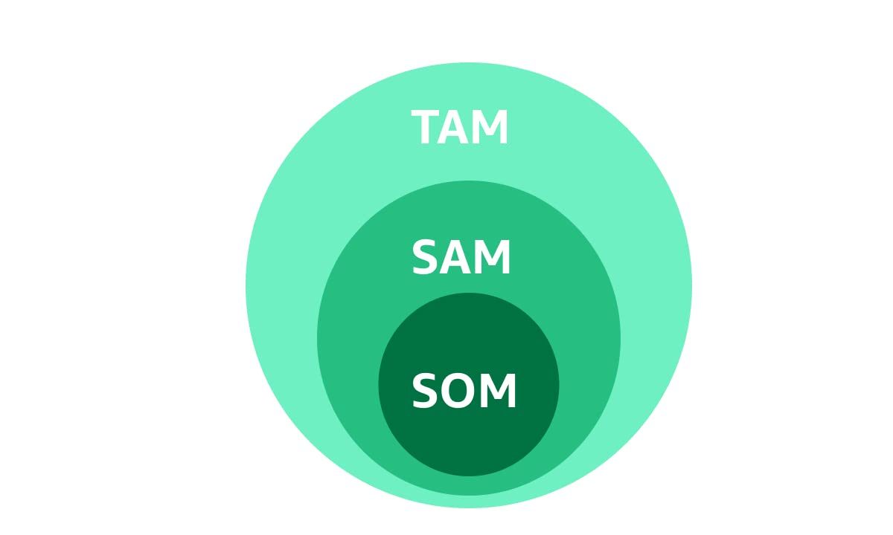
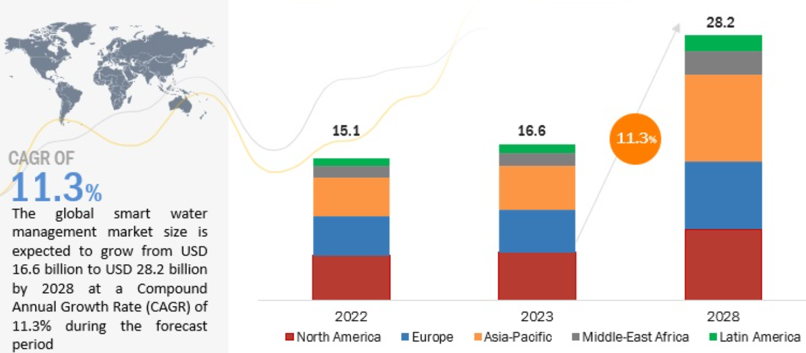
FEASIBILITY AND VIABILITY
AZTECS
Feasibility Analysis
Strategies for Overcoming Challenges
Improving Sensor Accuracy: Regular cleaning and recalibration of sensors
Ensuring Power Supply Reliability: Implement solar power or battery backups for uninterrupted operation
Regular System Maintenance: Periodic checks of valve and sensor functionality
Calibration and Monitoring: Automate recalibration and use dual-sensor systems for accuracy verification
15 -20 MILLION
TOTAL ADRESSABLE MARKET
Technical Feasibility: Components are readily available, and integration of sensor, microcontroller, and valve is feasible
Economic Feasibility: Affordable system components with long-term water conservation benefits
Operational Feasibility: Easy to use, low maintenance, with minimal manual intervention required
Environmental Feasibility: Reduces water wastage, scalable to different well sizes and regions
2-3 MILLION
SERVICE
ADRESSABLE
MARKET
0.001 – 0.003 MILLION
SERVICE
OBTAINABLE
MARKET
Viability Analysis
Potential Challenges and Risks
Market Viability: Addresses water conservation in water-stressed areas with a scalable solution
Cost-Benefit Analysis: Low installation costs with long-term savings from water conservation
Technical Viability: Uses proven, reliable technologies for each component
Regulatory Viability: Aligns with local and national water conservation policies
Pressure Sensor Accuracy: Sediment buildup may reduce accuracy over time
Power Supply Reliability: Unstable power may disrupt solenoid valve and microcontroller operations
System Calibration: Poor calibration may lead to inaccurate water level readings

Slide 6
RESEARCH AND REFERENCES
AZTECS
Research papers | Web resources | Books
Omar H. Kombo, SanthiKumaran, and Alastair Bovim, (2021), “ Design and Application of a Low-Cost, LowPower, LoRa-GSM, IoT Enabled System for Monitoring of Groundwater Resources With Energy Harvesting Integration”, IEEE Access. | Acquisition and Interpretation of Water-Level Data | 16 | v2 | Practic (taylorfrancis.com) | “Acquisition and Interpretation of Water-Level Data” By Matthew G. Dalton, Brent E. Huntsman, Ken Bradbury
YounessTace, Mohamed Tabaa, Sanaa Elfilali, CherkaouiLeghris, HassnaBensag, Eric Renault, “Smart irrigation system based on IoT and machine learning” Energy Reports, Volume 8, Supplement 9, 2022,Pages 1025-1036 | Water Level Monitoring Pressure Transducers—A Need for Industry‐Wide Standards - Sorensen - 2011 - Groundwater Monitoring & Remediation - Wiley Online Library | “Groundwater Monitoring & Remediation: Volume 31, Issue 4”
Khalifeh, A. Al-Qammaz, K. A. Darabkh, L. Abualigah, A. M. Khasawneh and Z. Zinonos, "An AI Based Irrigation and Weather Forecasting System utilizing LoRaWAN and Cloud Computing Technologies," 2021 IEEE Conference of Russian Young Researchers in Electrical and Electronic Engineering (ElConRus), St. Petersburg, Moscow, Russia, 2021, pp. 443-448, doi: 10.1109/ElConRus51938.2021.939643 | Water level sensing: State of the art review and performance evaluation of a low-cost measurement system - ScienceDirect | “Water level sensing: State of the art review and performance evaluation of a low-cost measurement system” By Konstantinos Loizou, Eftichios Koutroulis

